Slide 1




SC1015 Mini Project
ECAD1
Anusree Sreekumar (U2130223K)
Aruna D/O Vadivelu (U2130195C)
Shi Xinyu (U2130764L)

Slide 2


Table of Contents
01
Exploratory Data Analysis (EDA)
02
Motivation
03
04
Analysis
05
Conclusion
Machine Learning
Notes:
Motivation
Why we chose this particular topic
How we arrived at our problem statement
Our problem definition
EDA
Show the graphs for different factors for measuring the ladder score (which is the happiness index in this case)
Explain how we compare between each factors to shortlist the factors that we have chosen
Explain how we chose which region to train on
Machine Learning
Explain how we chose the three training models
Explain the results given by the three models
Analyse on whether the models are good/can be improved/which model is the best
Analysis
With the information found, what should we do? Eg prioritise on improving ___(factor)??????

Slide 3
01
Motivation

Slide 4
Motivation
In recent years, awareness for mental health has been increasing
Suicide rates are the second most common cause of death amongst youths
In view of this, we want to find out the happiness level of countries

Slide 5
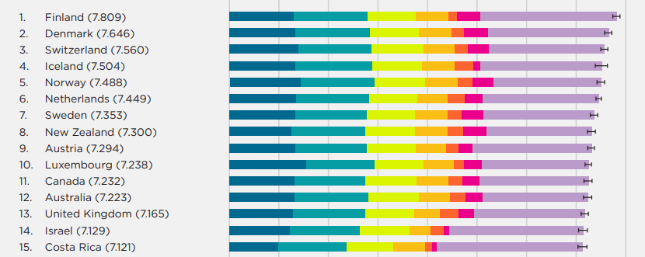
Motivation
Every year, the World Happiness Report surveys and ranks countries all over the world in terms of happiness level
Since it is hard to quantify happiness, we are interested in finding out how the index is determined

Slide 6
Problem Statement
Whether the variables determining the happiness index (ladder score) of the highest ranked region, can be used to determine the happiness index of other regions.

Slide 7
02
Exploratory Data Analysis

Slide 8


Data Cleaning
2
3
1
4
Checking of NULL values
Renaming columns to combine data
Skewness of Data
Dropping of unnecessary columns
Notes:
Detecting of outliers: Even though there are data that seems to be unfitting in this data set, it it necessary to keep these data points as it is important to see why the happiness index of that particular country in that particular year is so high or so low.

Slide 9
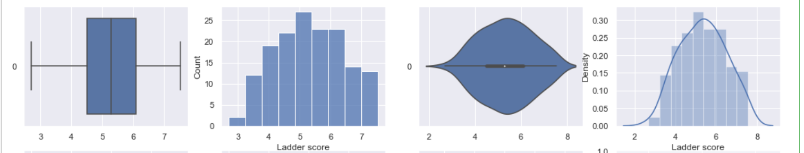
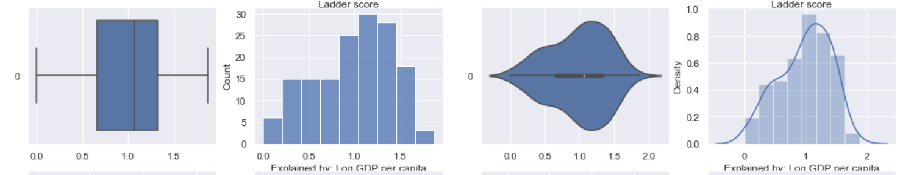
Data Visualisations of all factors
Ladder Score
Logged GDP per Capita

Slide 10
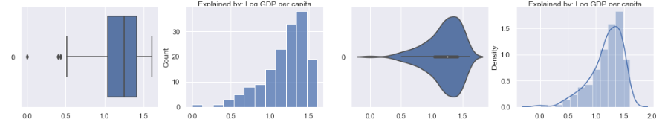
Data Visualisations of all factors
Social Support
Healthy Life Expectancy

Slide 11
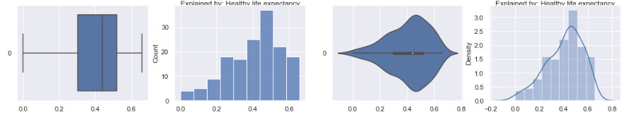
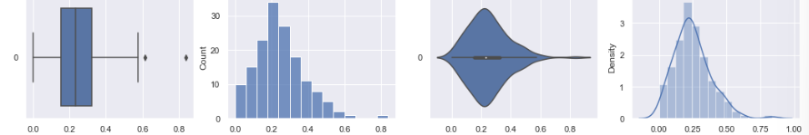
Data Visualisations of all factors
Freedom to make life choices
Generosity

Slide 12
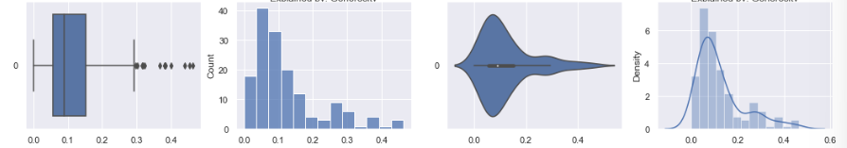
Data Visualisations of all factors
Perceptions of corruption
Conclusion: Since the graphs for all 5 years are relatively the same, we have decided to combine the data sets

Slide 13
We combined 5 years of data into one DataFrame
2017
2018
2019
2020
2021

Slide 14
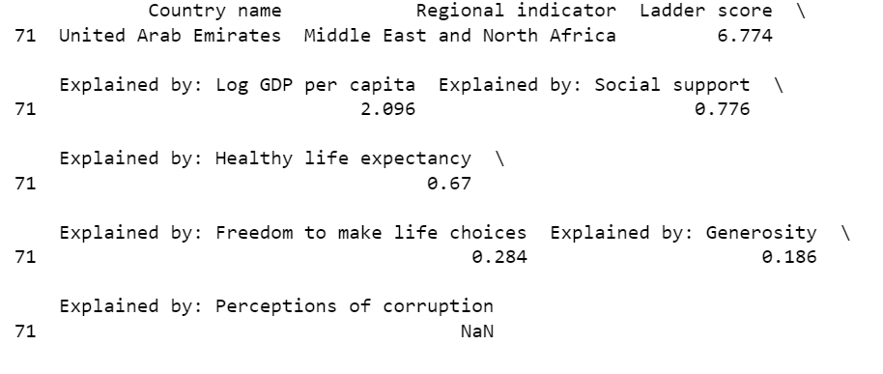
Checking of NaN Values
We replaced the NaN values with the mean of the other years

Slide 15
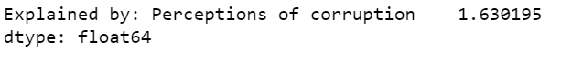
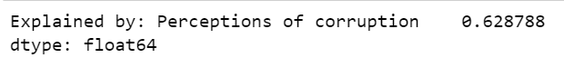
Correcting Skewness of Data
Before correcting:
After correcting (taking square root):

Slide 16
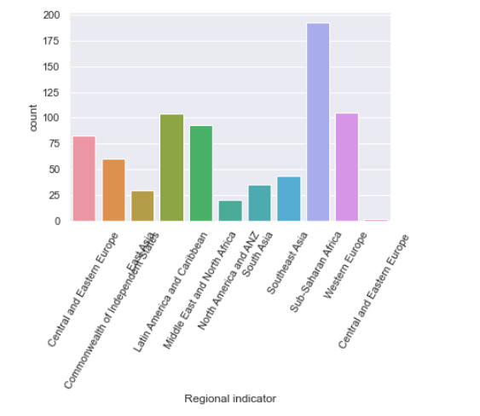
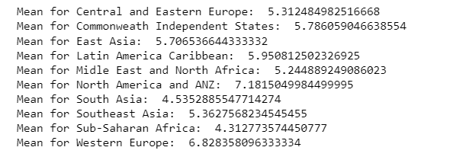
To choose the region with the highest mean ladder score

Slide 17
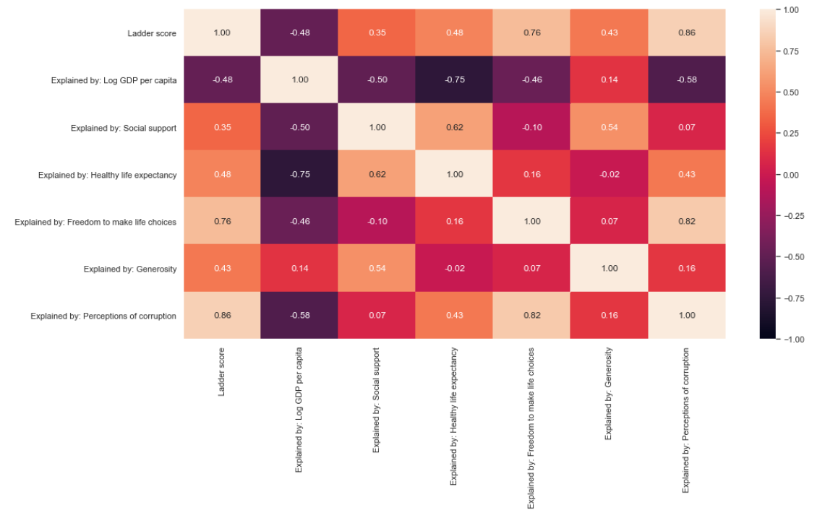
Factors that we have chosen
GDP Per Capita
Social Support
Healthy Life Expectancy
We compared the correlation of ladder score vs all other variables

Slide 18
Problem Statement (Updated)
Whether the variables of GDP Per Capita, Freedom to make life choices and Perceptions of Corruption for Western Europe can be used to determine the happiness index of other regions

Slide 19
03
Machine Learning

Slide 20
Linear regression tools
01
Univariate Linear Regression
02
Random Forest
03
XGBoost

Slide 21
In-depth explanation of the 3 models
Univariate
Linear
Regression
Random
Forest
XGBoost
Estimate linear relationship between independent variables (GDP, Perceptions of Corruption & Freedom) and Ladder Score
Uses ensemble learning method for regression
Builds n decision tree regressors which predicts a number
Average of the predictions taken as final output
More accurate than univariate linear regression
Supposedly the best linear regression model
Implements Machine Learning algorithms under the Gradient Boosting framework
Provides a parallel tree boosting to solve many data science problems in an accurate way

Slide 22

Solution Pathway
Step 1
Step 2
Step 3
Training and testing all three models on Western Europe data set for all three variables.
Determining the best model to test on all other regions.
Analysing accuracy of predictions.

Slide 23
Logged GDP per capita

Slide 24
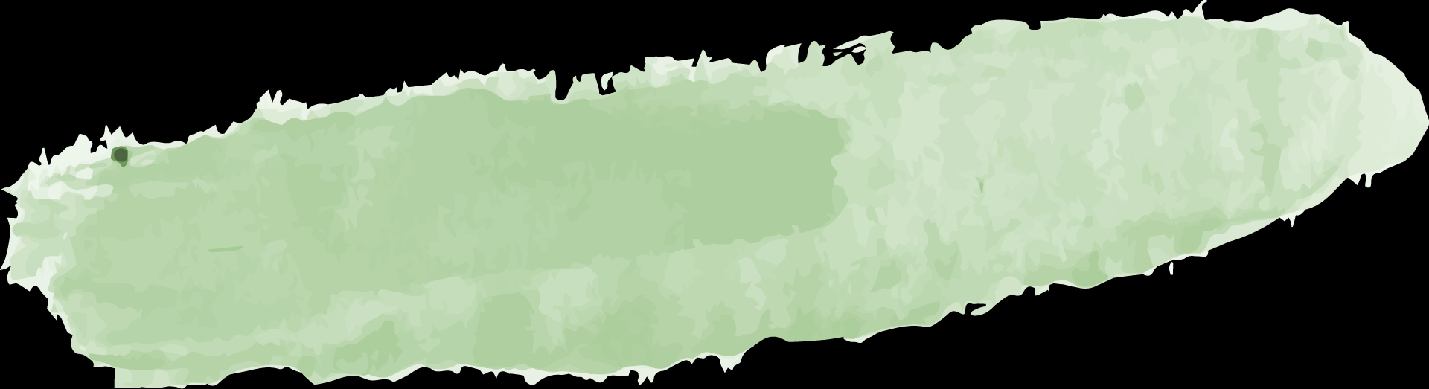
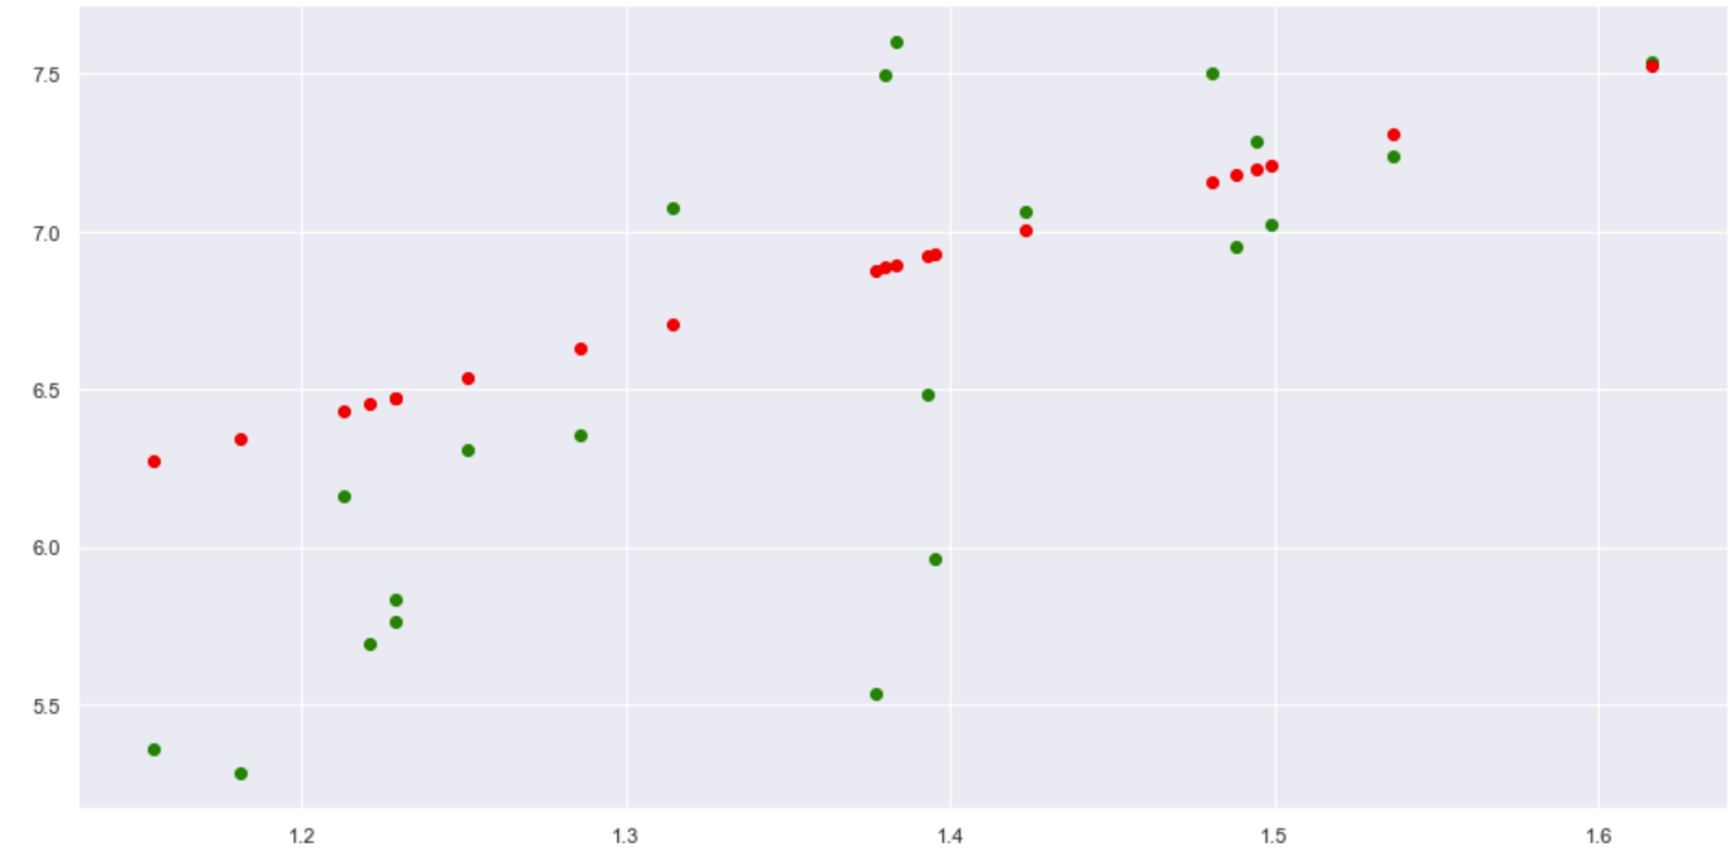
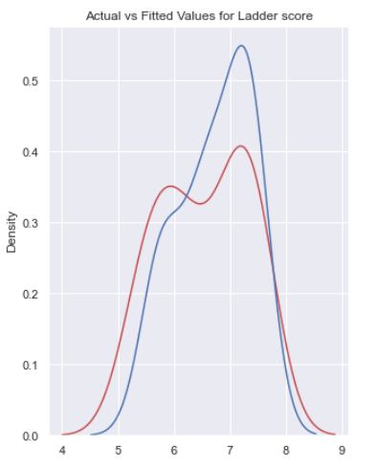
Determining the best model
Univariate Linear Regression
Random Forest
XGBoost
MSE = 1.42
MSE = 0.371
MSE = 0.479

Slide 25
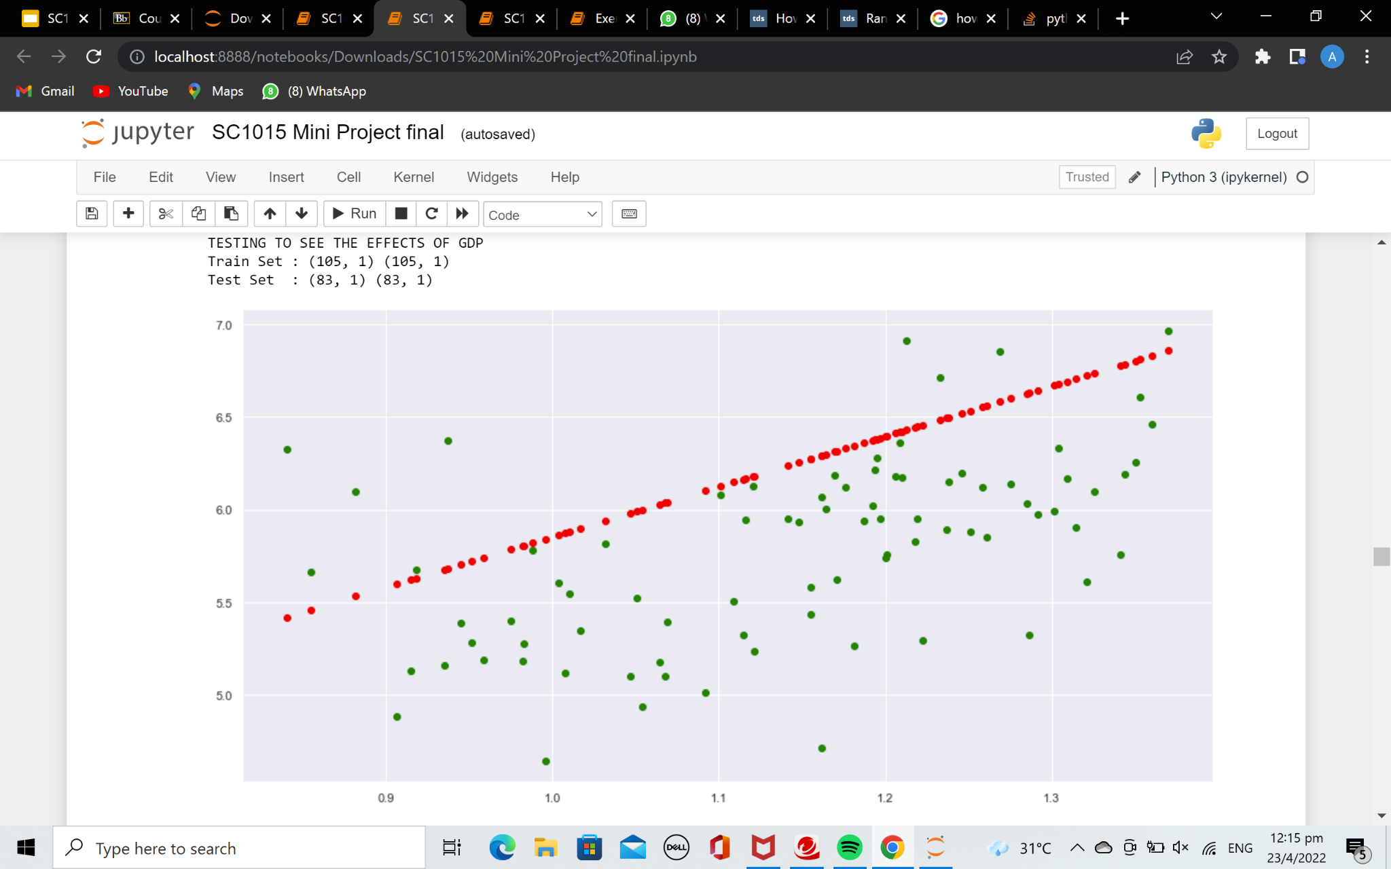
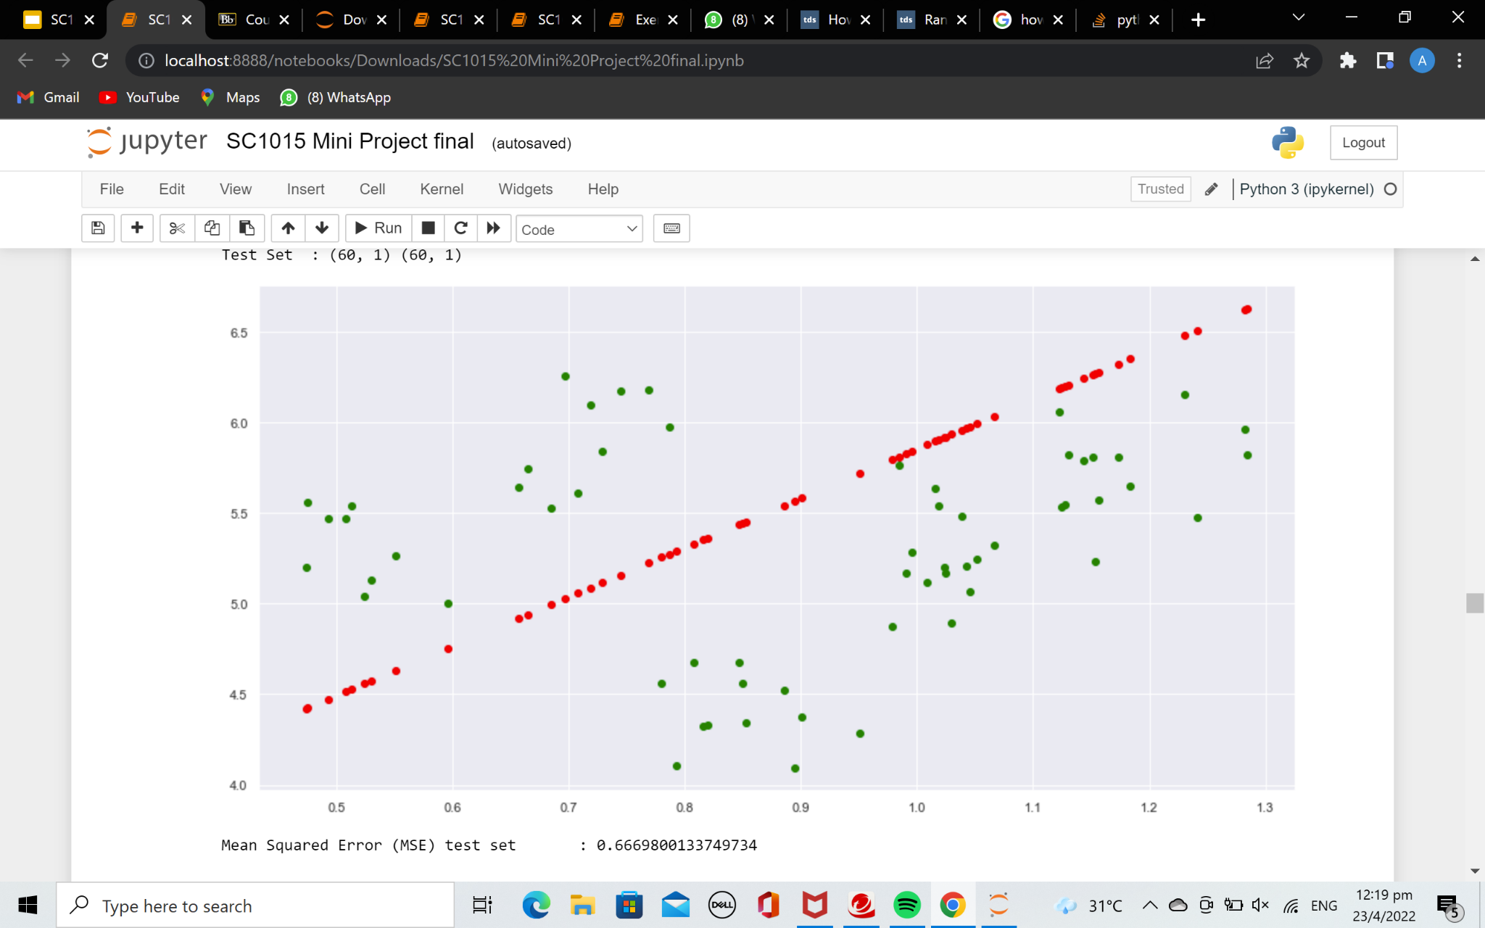
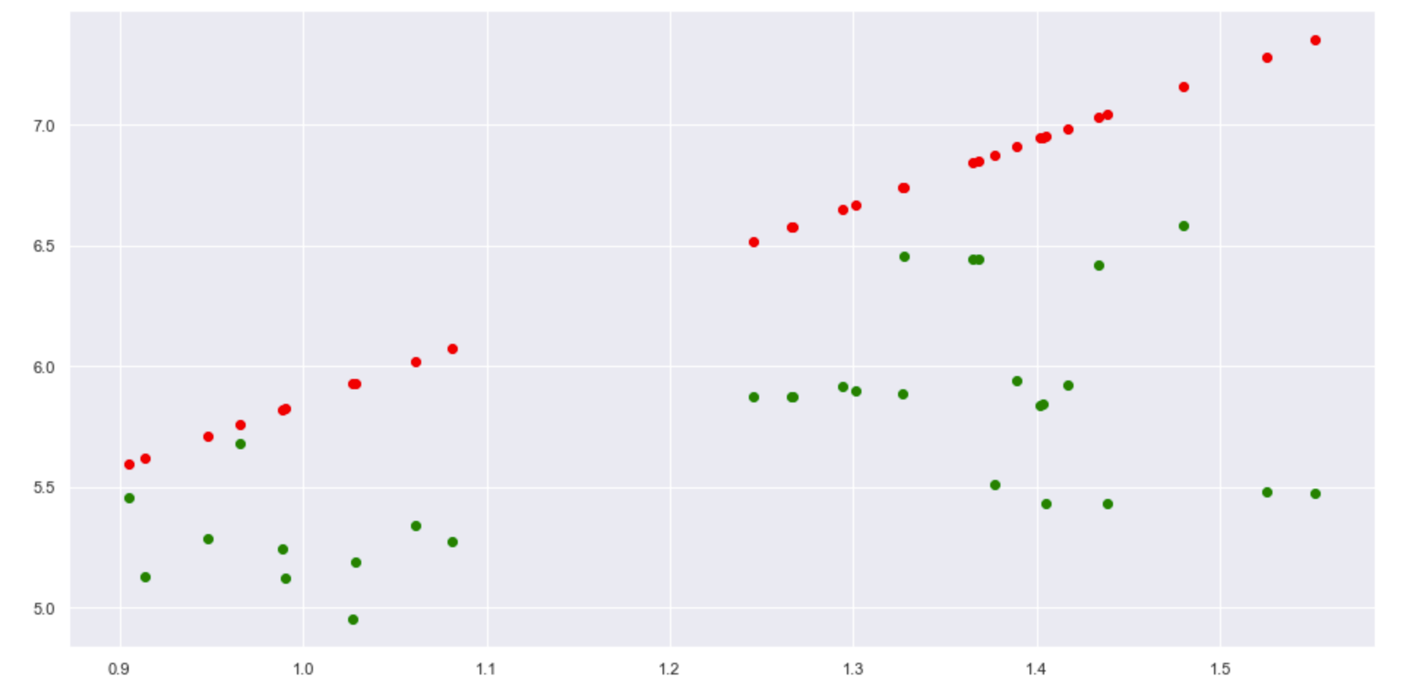
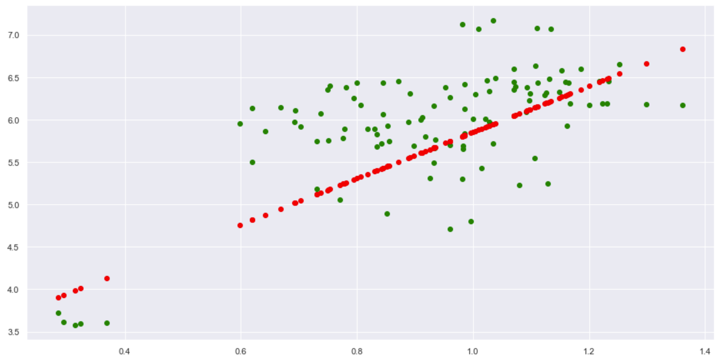
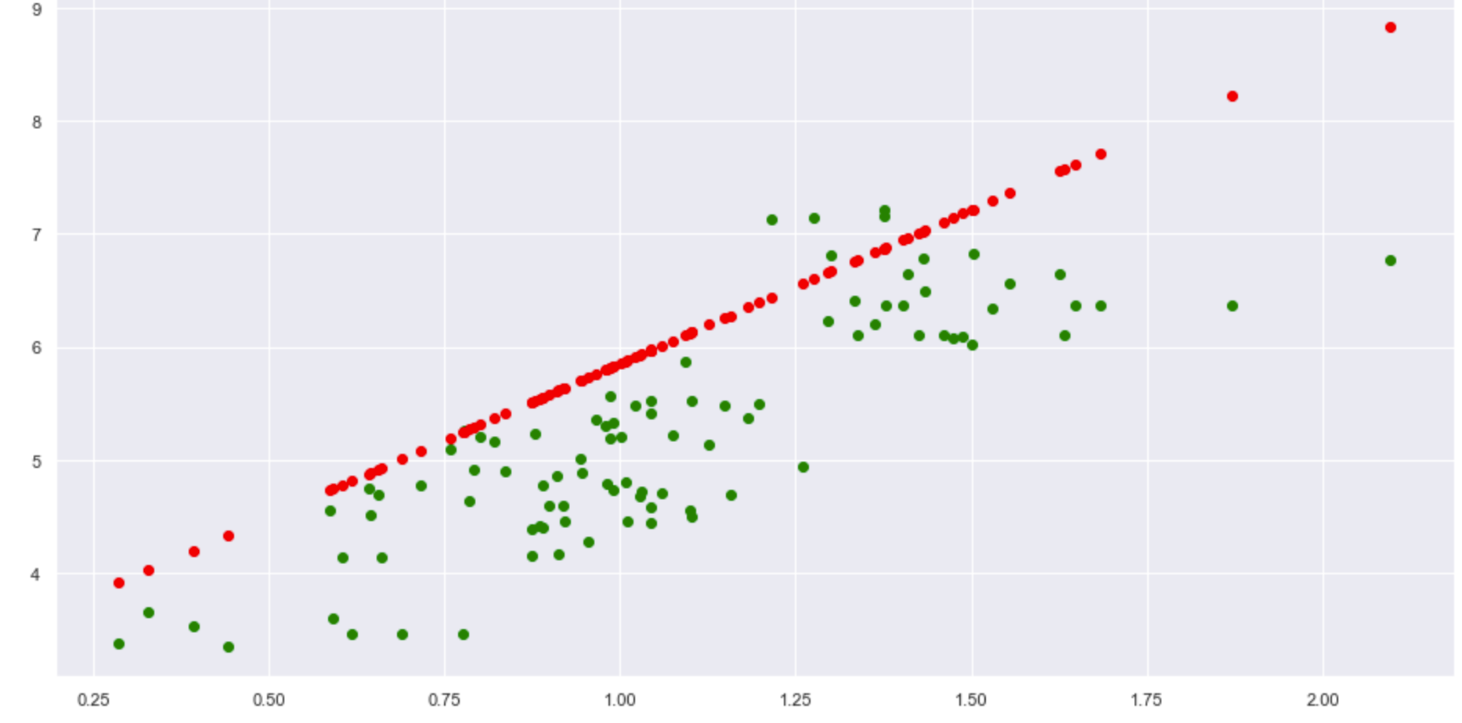
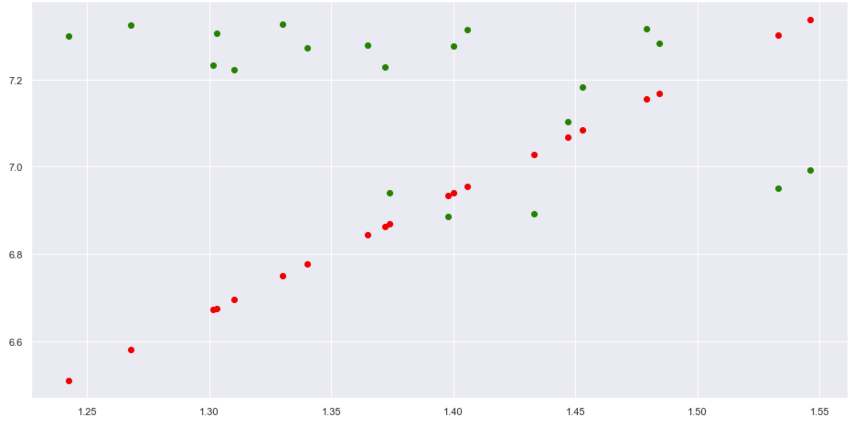
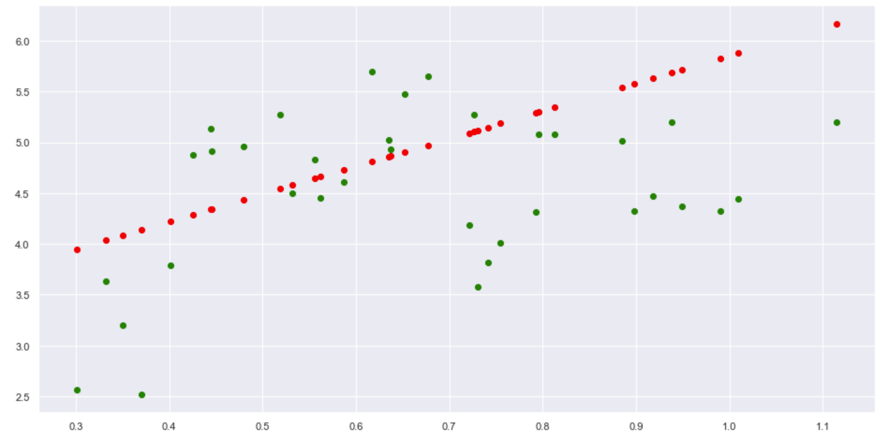
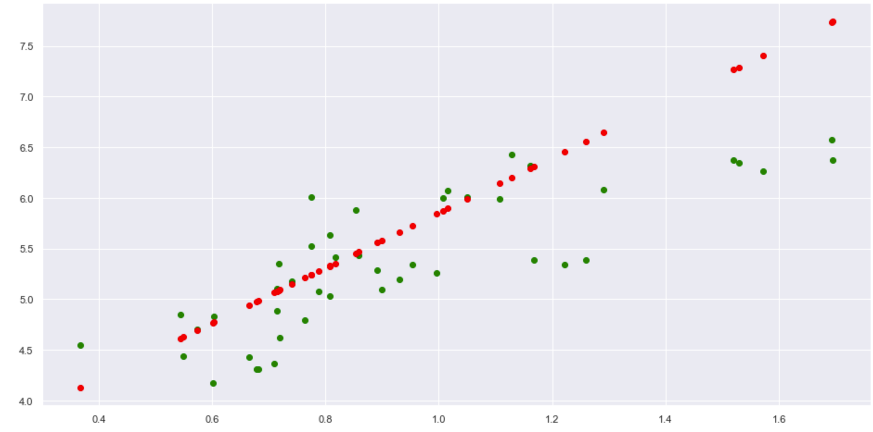
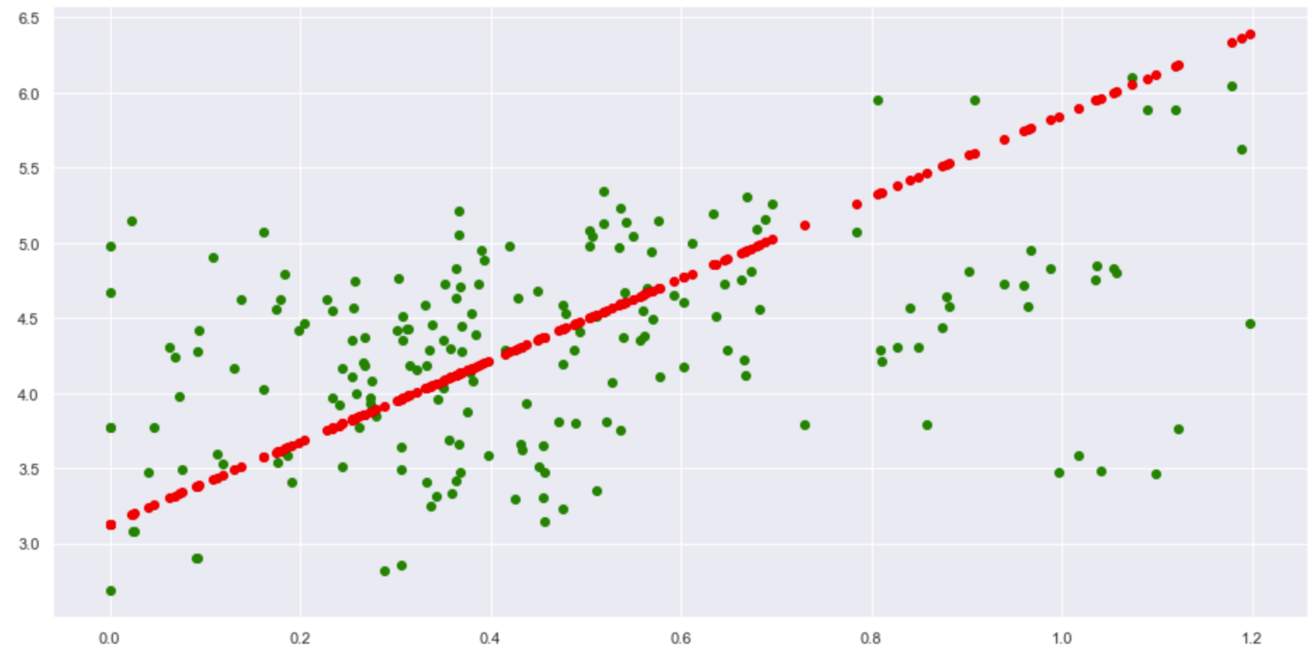
Central and Eastern Europe
Commonwealth of Independent States
East Asia
Latin America and Caribbean
Middle East and North Africa
North America and ANZ
South Asia
Southeast Asia
Sub-Saharan Africa

Slide 26
Testing effects of GDP on Ladder Score
Region | Mean Squared Error (MSE)
Central and Eastern Europe | 0.398
Commonwealth of Independent States | 0.667
East Asia | 0.878
Latin America and Caribbean | 0.383
Middle East and North Africa | 0.906
North America and ANZ | 0.181
South Asia | 0.781
Southeast Asia | 0.341
Sub-Saharan Africa | 0.637

Slide 27
Perceptions of Corruption

Slide 28
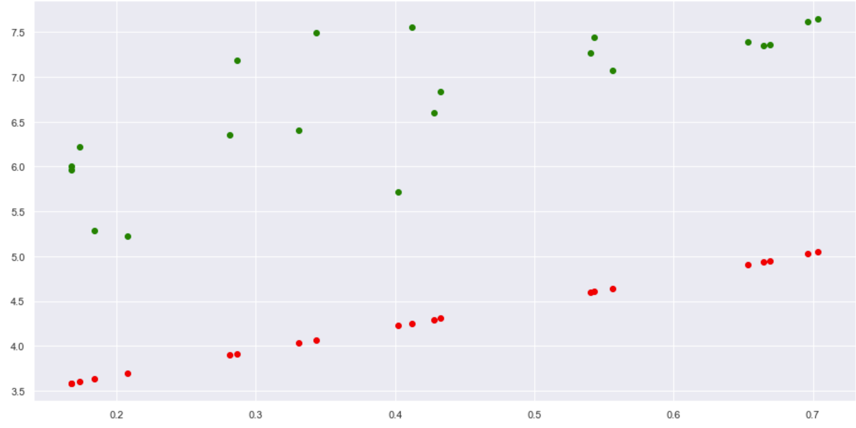
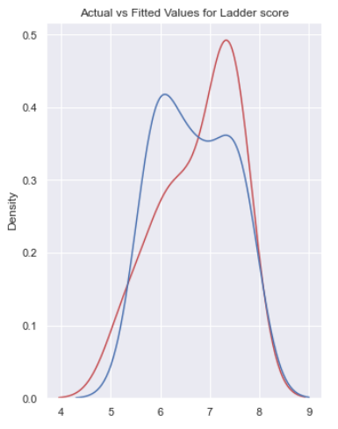
Determining the best model
Univariate Linear Regression
Random Forest
XGBoost
MSE = 0.800
MSE = 6.41
MSE = 0.192

Slide 29
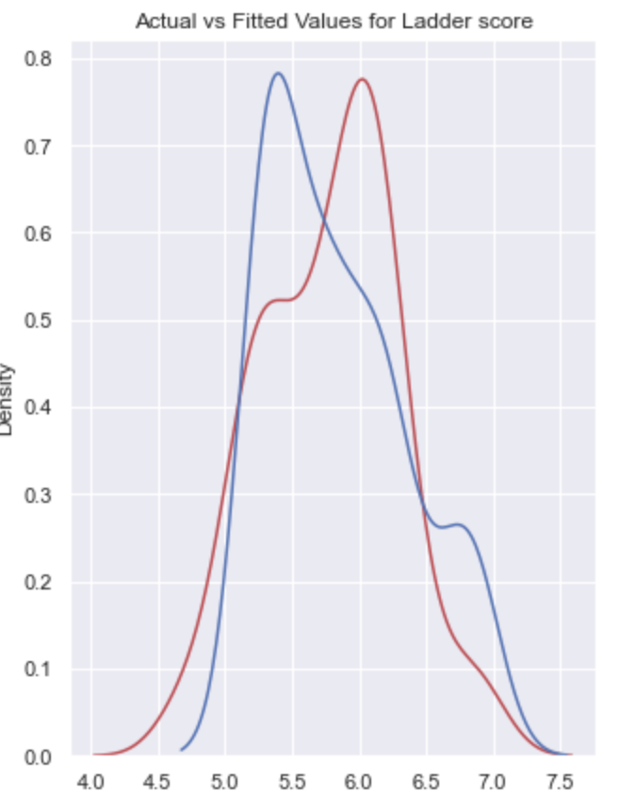
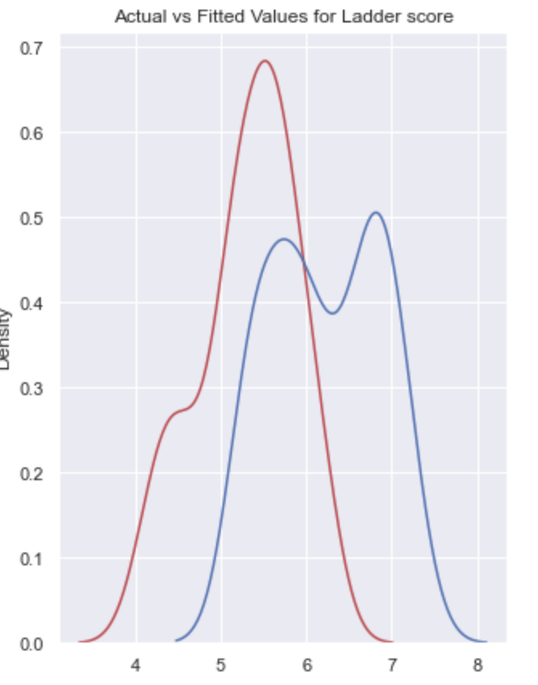
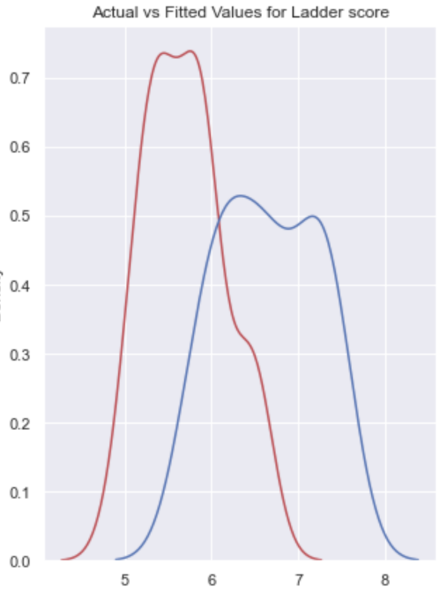
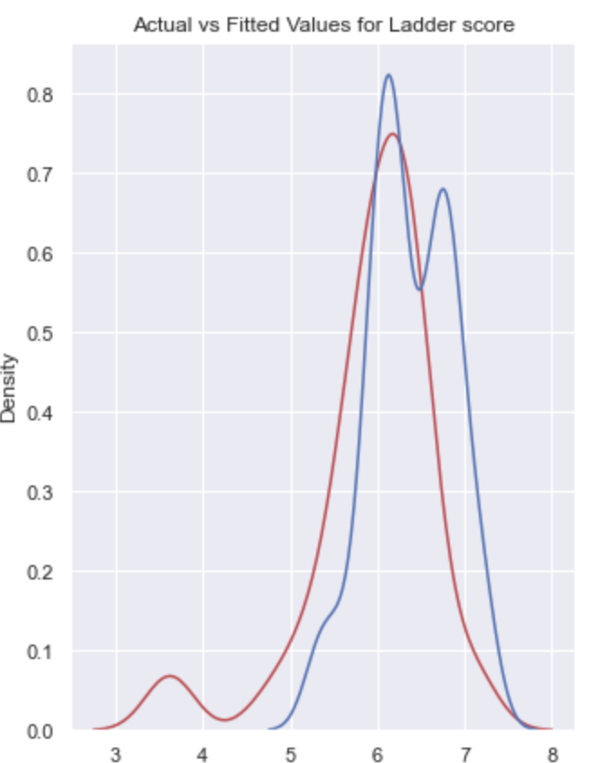
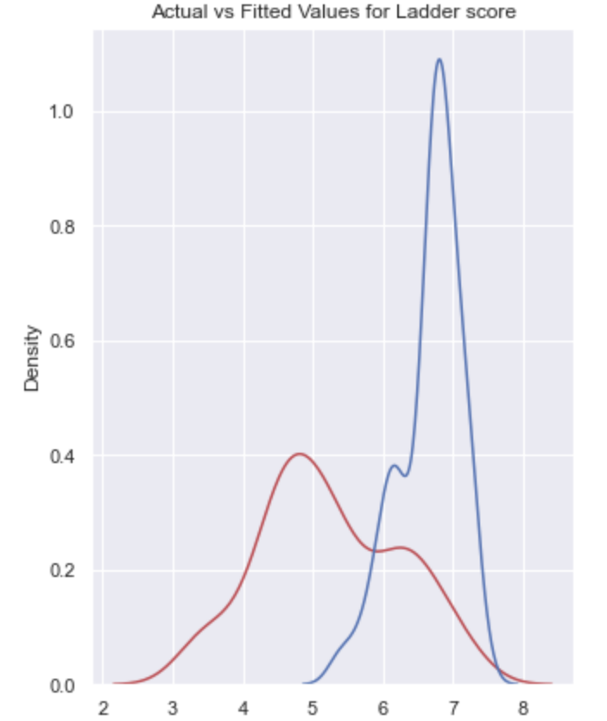
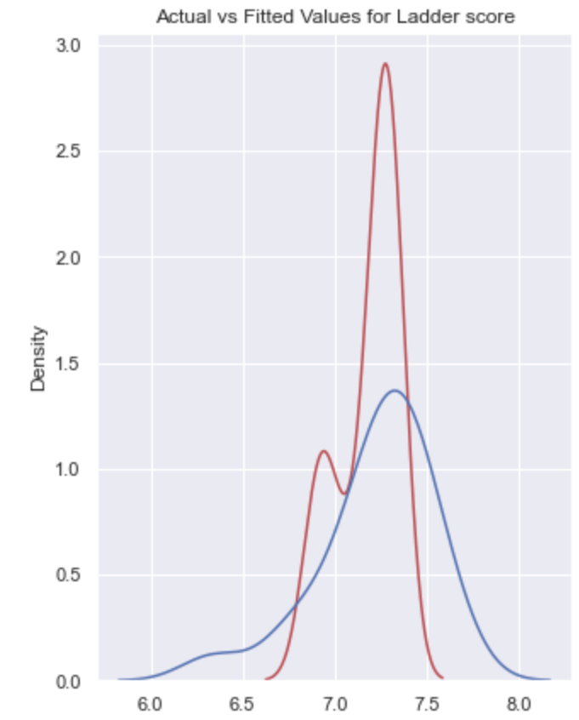
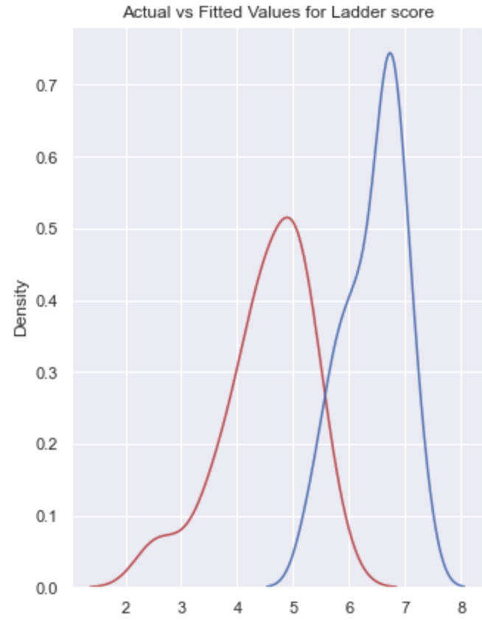
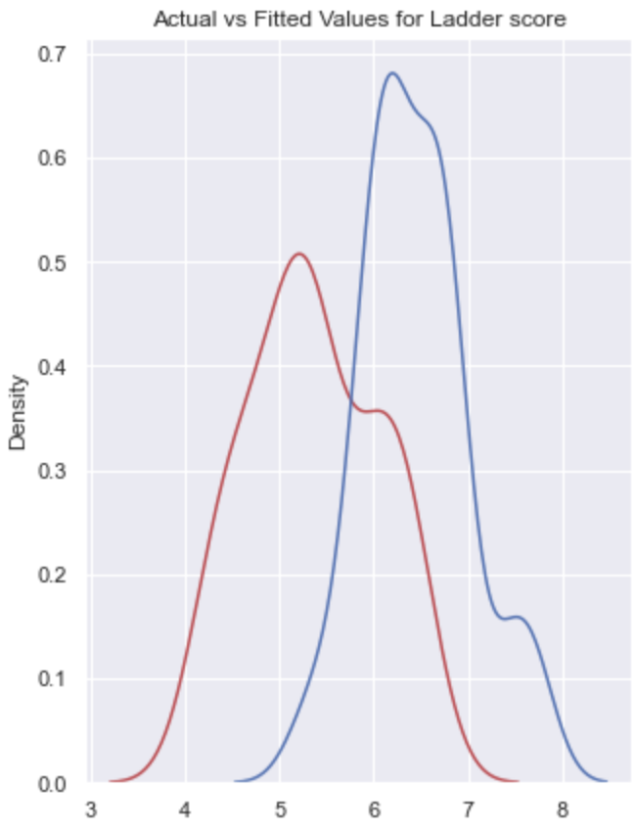
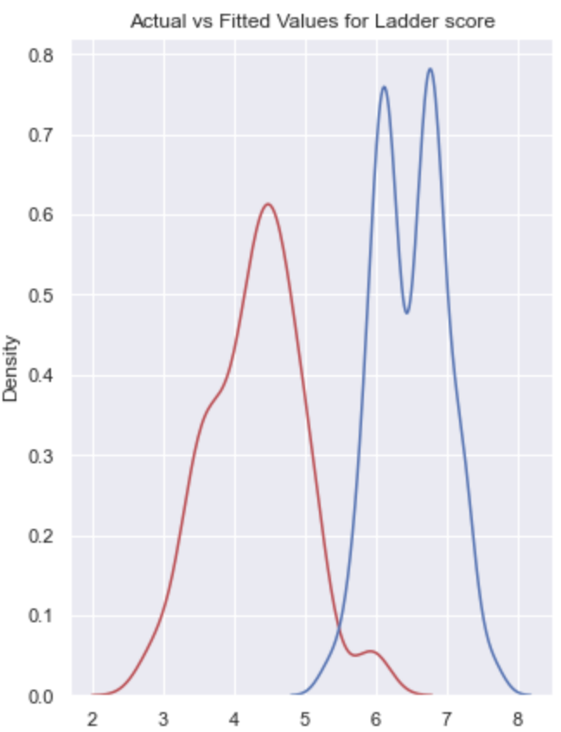
Central and Eastern Europe
Commonwealth of Independent States
East Asia
Latin America and Caribbean
Middle East and North Africa
North America and ANZ
South Asia
Southeast Asia
Sub-Saharan Africa

Slide 30
Testing effects of Corruption on Ladder Score
Region | Mean Squared Error (MSE)
Central and Eastern Europe | 0.483
Commonwealth of Independent States | 1.39
East Asia | 1.34
Latin America and Caribbean | 0.882
Middle East and North Africa | 2.92
North America and ANZ | 0.0616
South Asia | 4.03
Southeast Asia | 1.74
Sub-Saharan Africa | 5.55

Slide 31
Freedom to make life choices

Slide 32
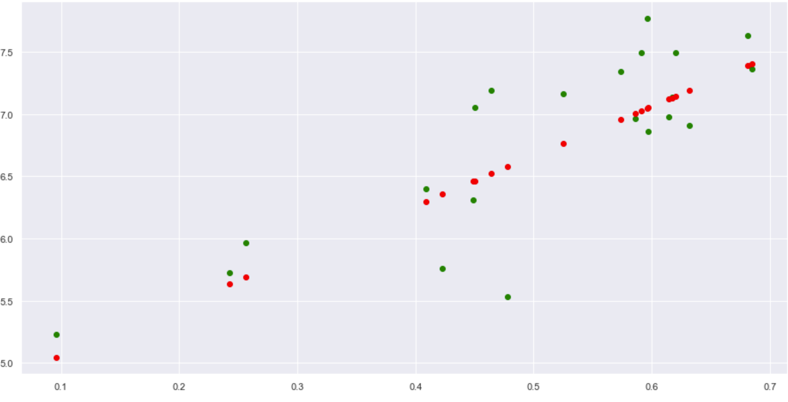
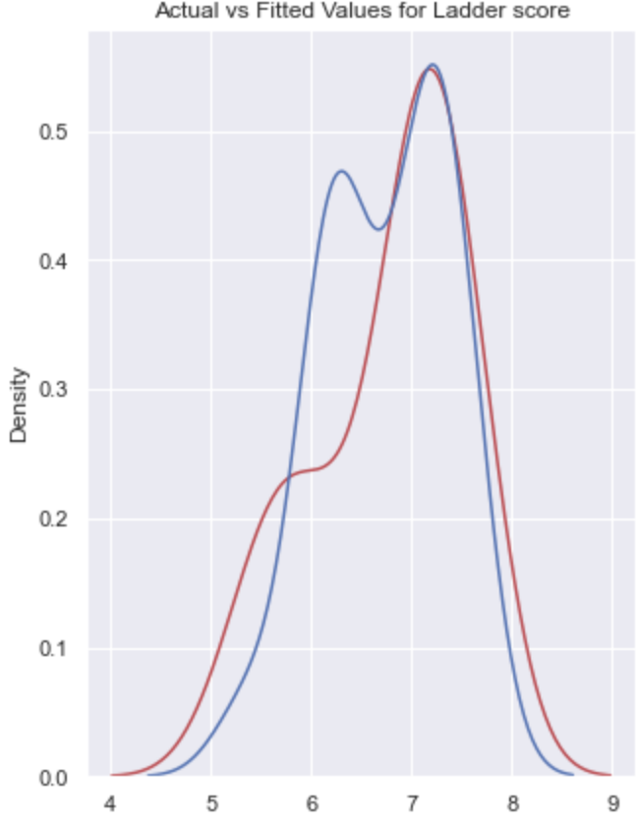
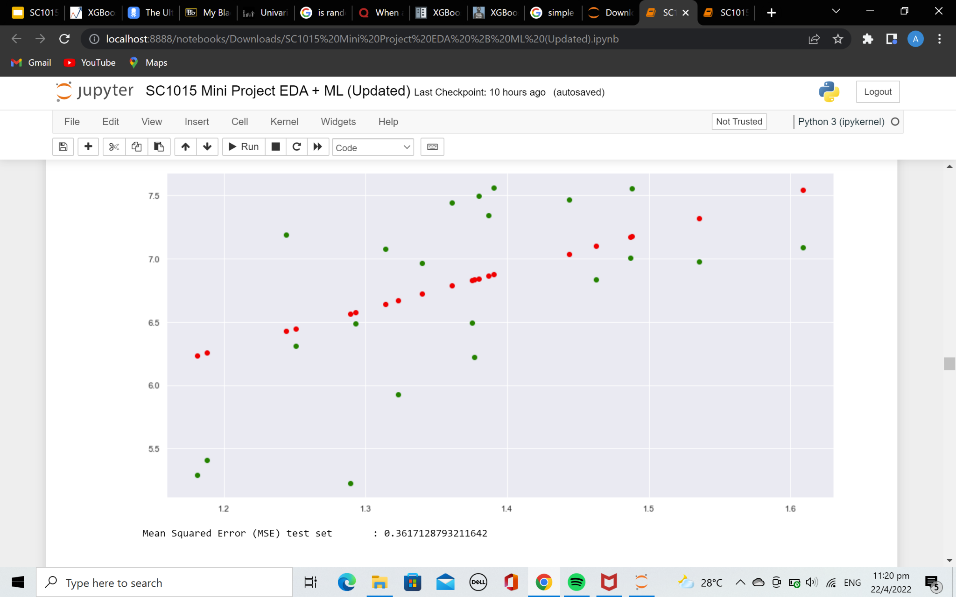
Determining the best model
Univariate Linear Regression
Random Forest
XGBoost
MSE = 0.800
MSE = 0.178
MSE = 0.243

Slide 33
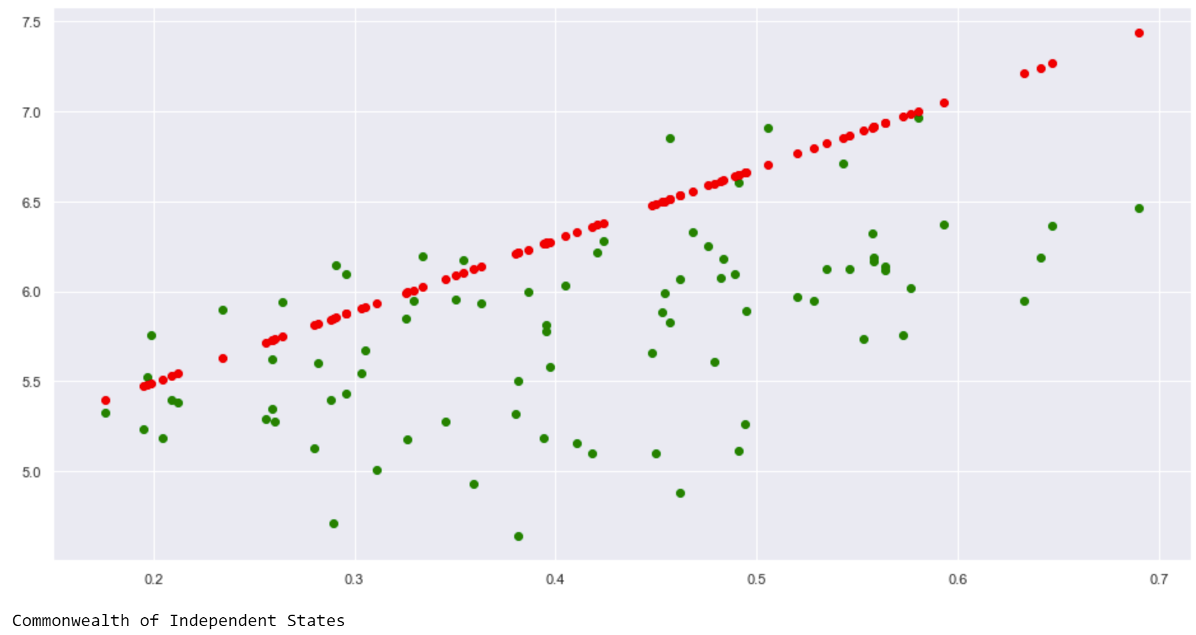
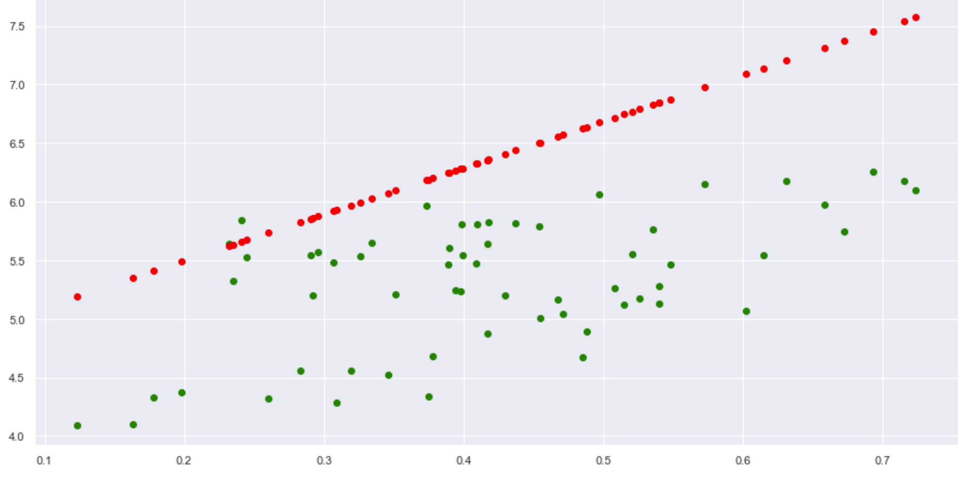
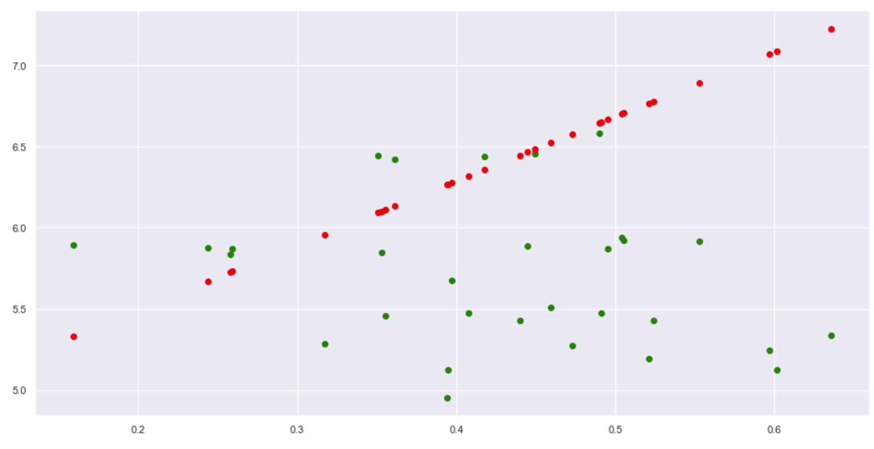
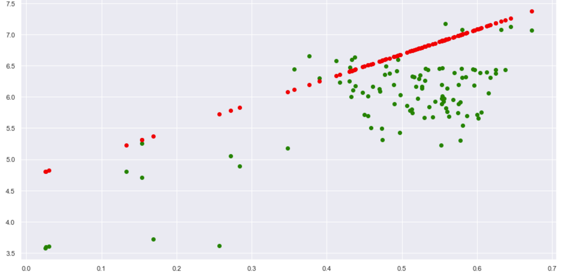
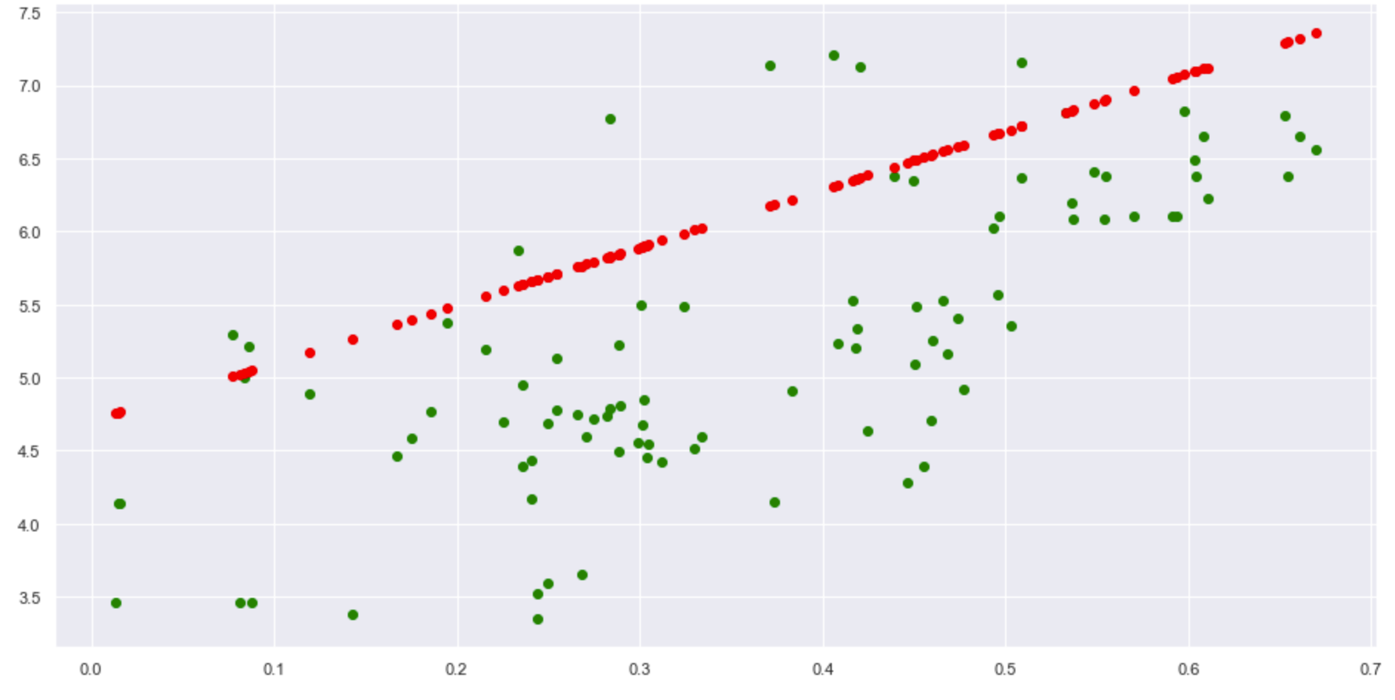
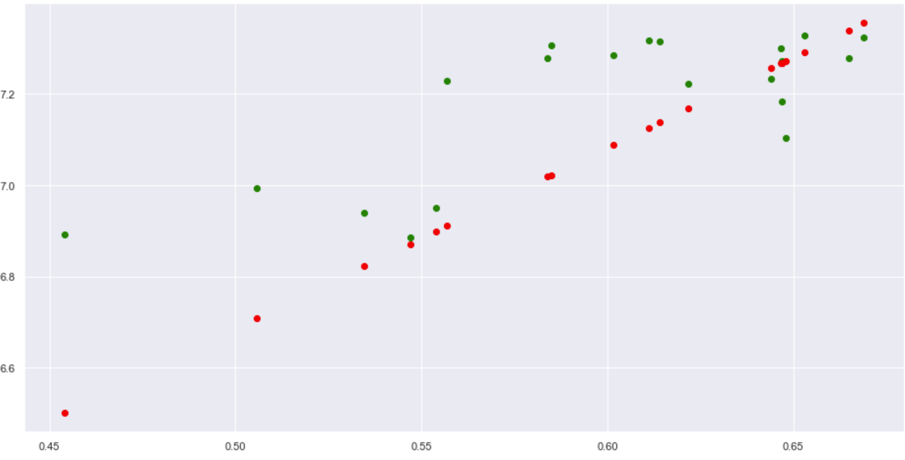
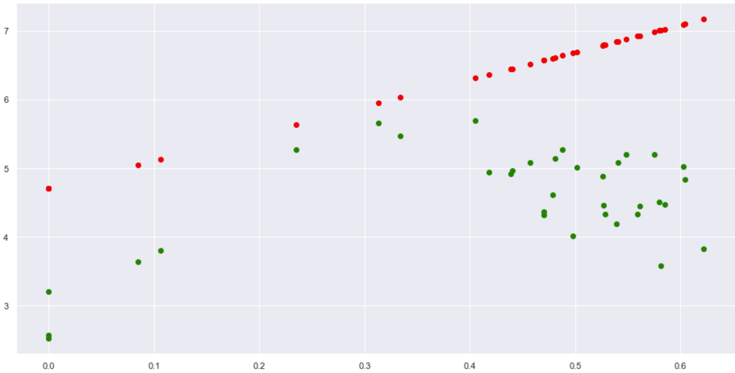
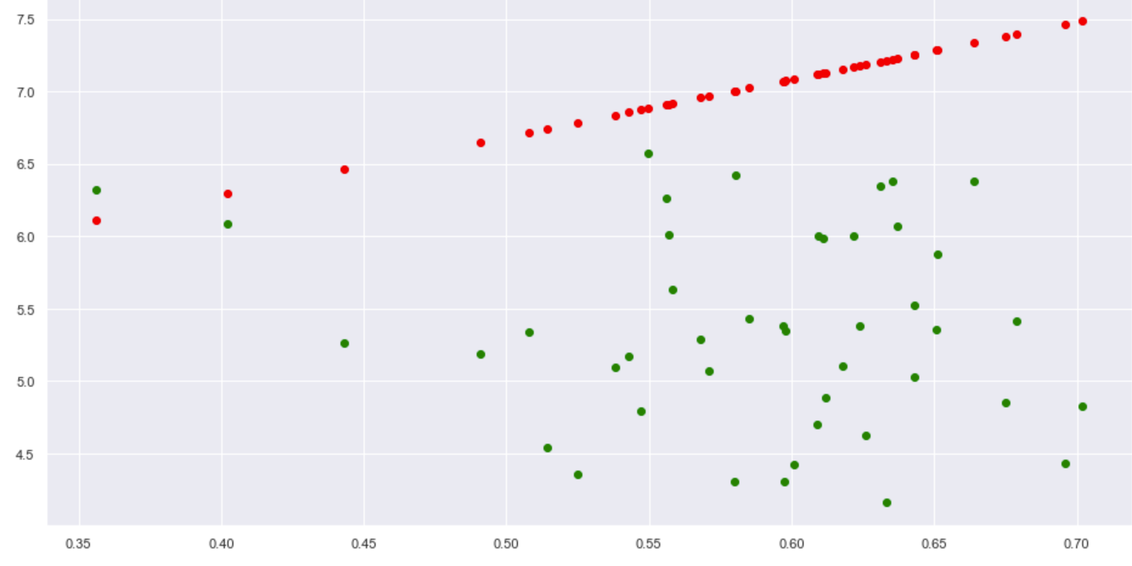
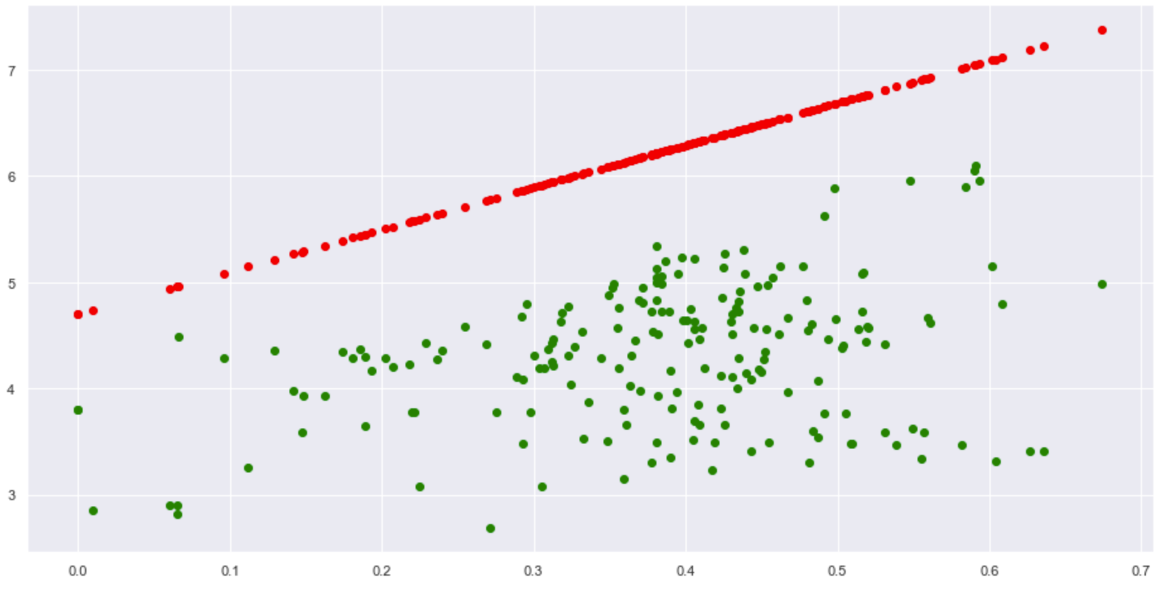
Central and Eastern Europe
Commonwealth of Independent States
East Asia
Latin America and Caribbean
Middle East and North Africa
North America and ANZ
South Asia
Southeast Asia
Sub-Saharan Africa

Slide 34
Testing effects of Freedom on Ladder Score
Region | Mean Squared Error (MSE)
Central and Eastern Europe | 0.525
Commonwealth of Independent States | 1.39
East Asia | 0.966
Latin America and Caribbean | 0.715
Middle East and North Africa | 1.28
North America and ANZ | 0.0326
South Asia | 4.06
Southeast Asia | 3.37
Sub-Saharan Africa | 4.12

Slide 35
What we learned
Random forest regression
XGBoost
Insights from our ML
Predicting happiness index of other regions from the variables that affect ladder score in Western Europe may not be accurate
Each country has its specific variables that affect the ladder score

Slide 36
04
Analysis

Slide 37


Accurate Predictions
Perceptions of corruption
Freedom to make life choices
GDP per capita
North America and ANZ
Central and Eastern Europe
North America and ANZ
Southeast Asia
North America and ANZ
Central and Eastern Europe

Slide 38
Trend in our predictions
For models that give a more accurate prediction, they are mostly regions with a higher number of developed countries
Factors affecting happiness level in developed countries is different from that of developing countries

Slide 39
05
Conclusion

Slide 40
What can we do about this?
For the developed countries, since the factors affecting happiness index is the same, they are able to adopt the methods that the happiest countries are using
For developing countries, look into the specificities of the country (governance , culture e.t.c) and choose variables tailored to them to improve on the happiness index

Slide 41
THANK
YOU
Please keep this slide for attribution

